Slide 1
Calculation and coordination
Essays on socialism and transitional political economy
By: Peter j. Boettke
Presented by: Wyatt Platts

Slide 2
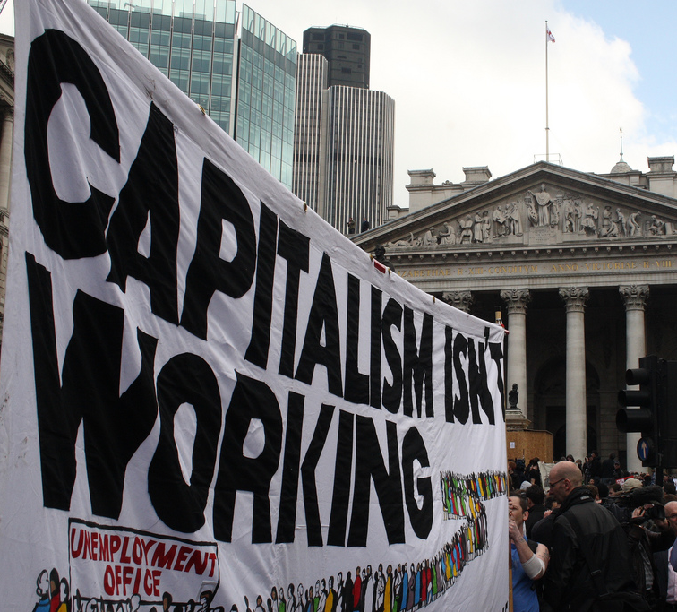
Goal:
Connect, explain, and understand the failures of socialism
Examples include:
Austria
Russias' transition from socialism to liberal economics
This Photo by Unknown author is licensed under CC BY-SA.

Slide 3
How does this work achieve this? Austrian Example
Market-process tradition
Political Economy of Public Choice
Hayek – criticized socialism through a variety of lenses
Political
Social
Economic
Use economic tools in regards political science
Value-freedom

Slide 4
Why are there no Austrian socialists?
"Wertfreiheit" - value-freedom
Mises - "economics is apolitical...although it is the foundation of politics and of every kind of political action".
Austrian Case v. Neoclassical Interpretation
Vision v. Analysis
This view is not as viable as it once was considered

Slide 5
The Austrian contribution to political economy
Most important contribution – economic calculation
What is economic calculation?
"decision-making ability to allocate scarce capital resources among competing uses"
Mise: decision-making ability is dependent on the institutional context of private property.

Slide 6
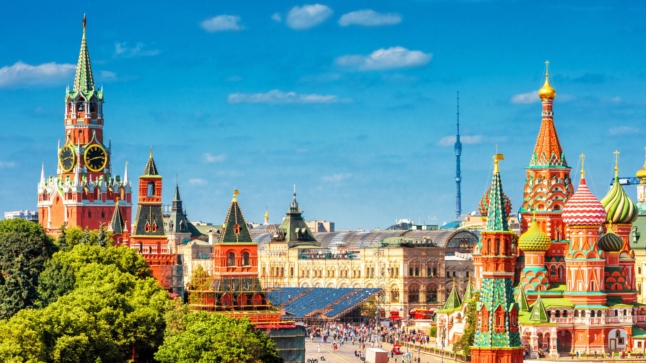
The Russian Example
Soviet Times
Post-Soviet (Attempted) Transformation
Relied upon rich natural resources
"Eroded" worth of oil stocks
Factor in collapse of the system
Attempt to establish a "dual transformation" in politics and economics
30% of the population lived on less than $40/month
"Here" wasn't specified and "there" was not defined

Slide 7
The political infrastructure of economic development
What is the difference between the first, second, and third world?
What is needed to create more understanding?
Developed v. Underdeveloped
Capitalist v. Non-capitalist
Lange – economics is a universal science
Detailed historical studies of development across countries

Slide 8
Soviet venality
Why did Perestroika fail?
Moved too quickly
Reforms failed
Could not gain enough political support

Slide 9
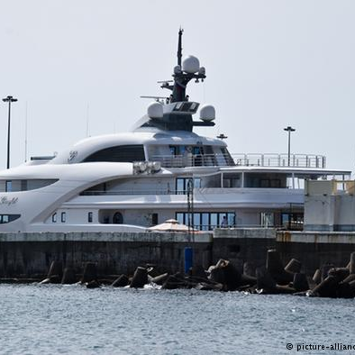
Nomenklatura
A large, powerful, highly organized and cohesive interest group whose members benefitted from the (Soviet) status quo.
Issues of credibility and commitment
Optimal intervention – large degree of discretionary control be entrusted to government decision-makers.
This Photo by Unknown author is licensed under CC BY-SA.
This Photo by Unknown author is licensed under CC BY.

Slide 10
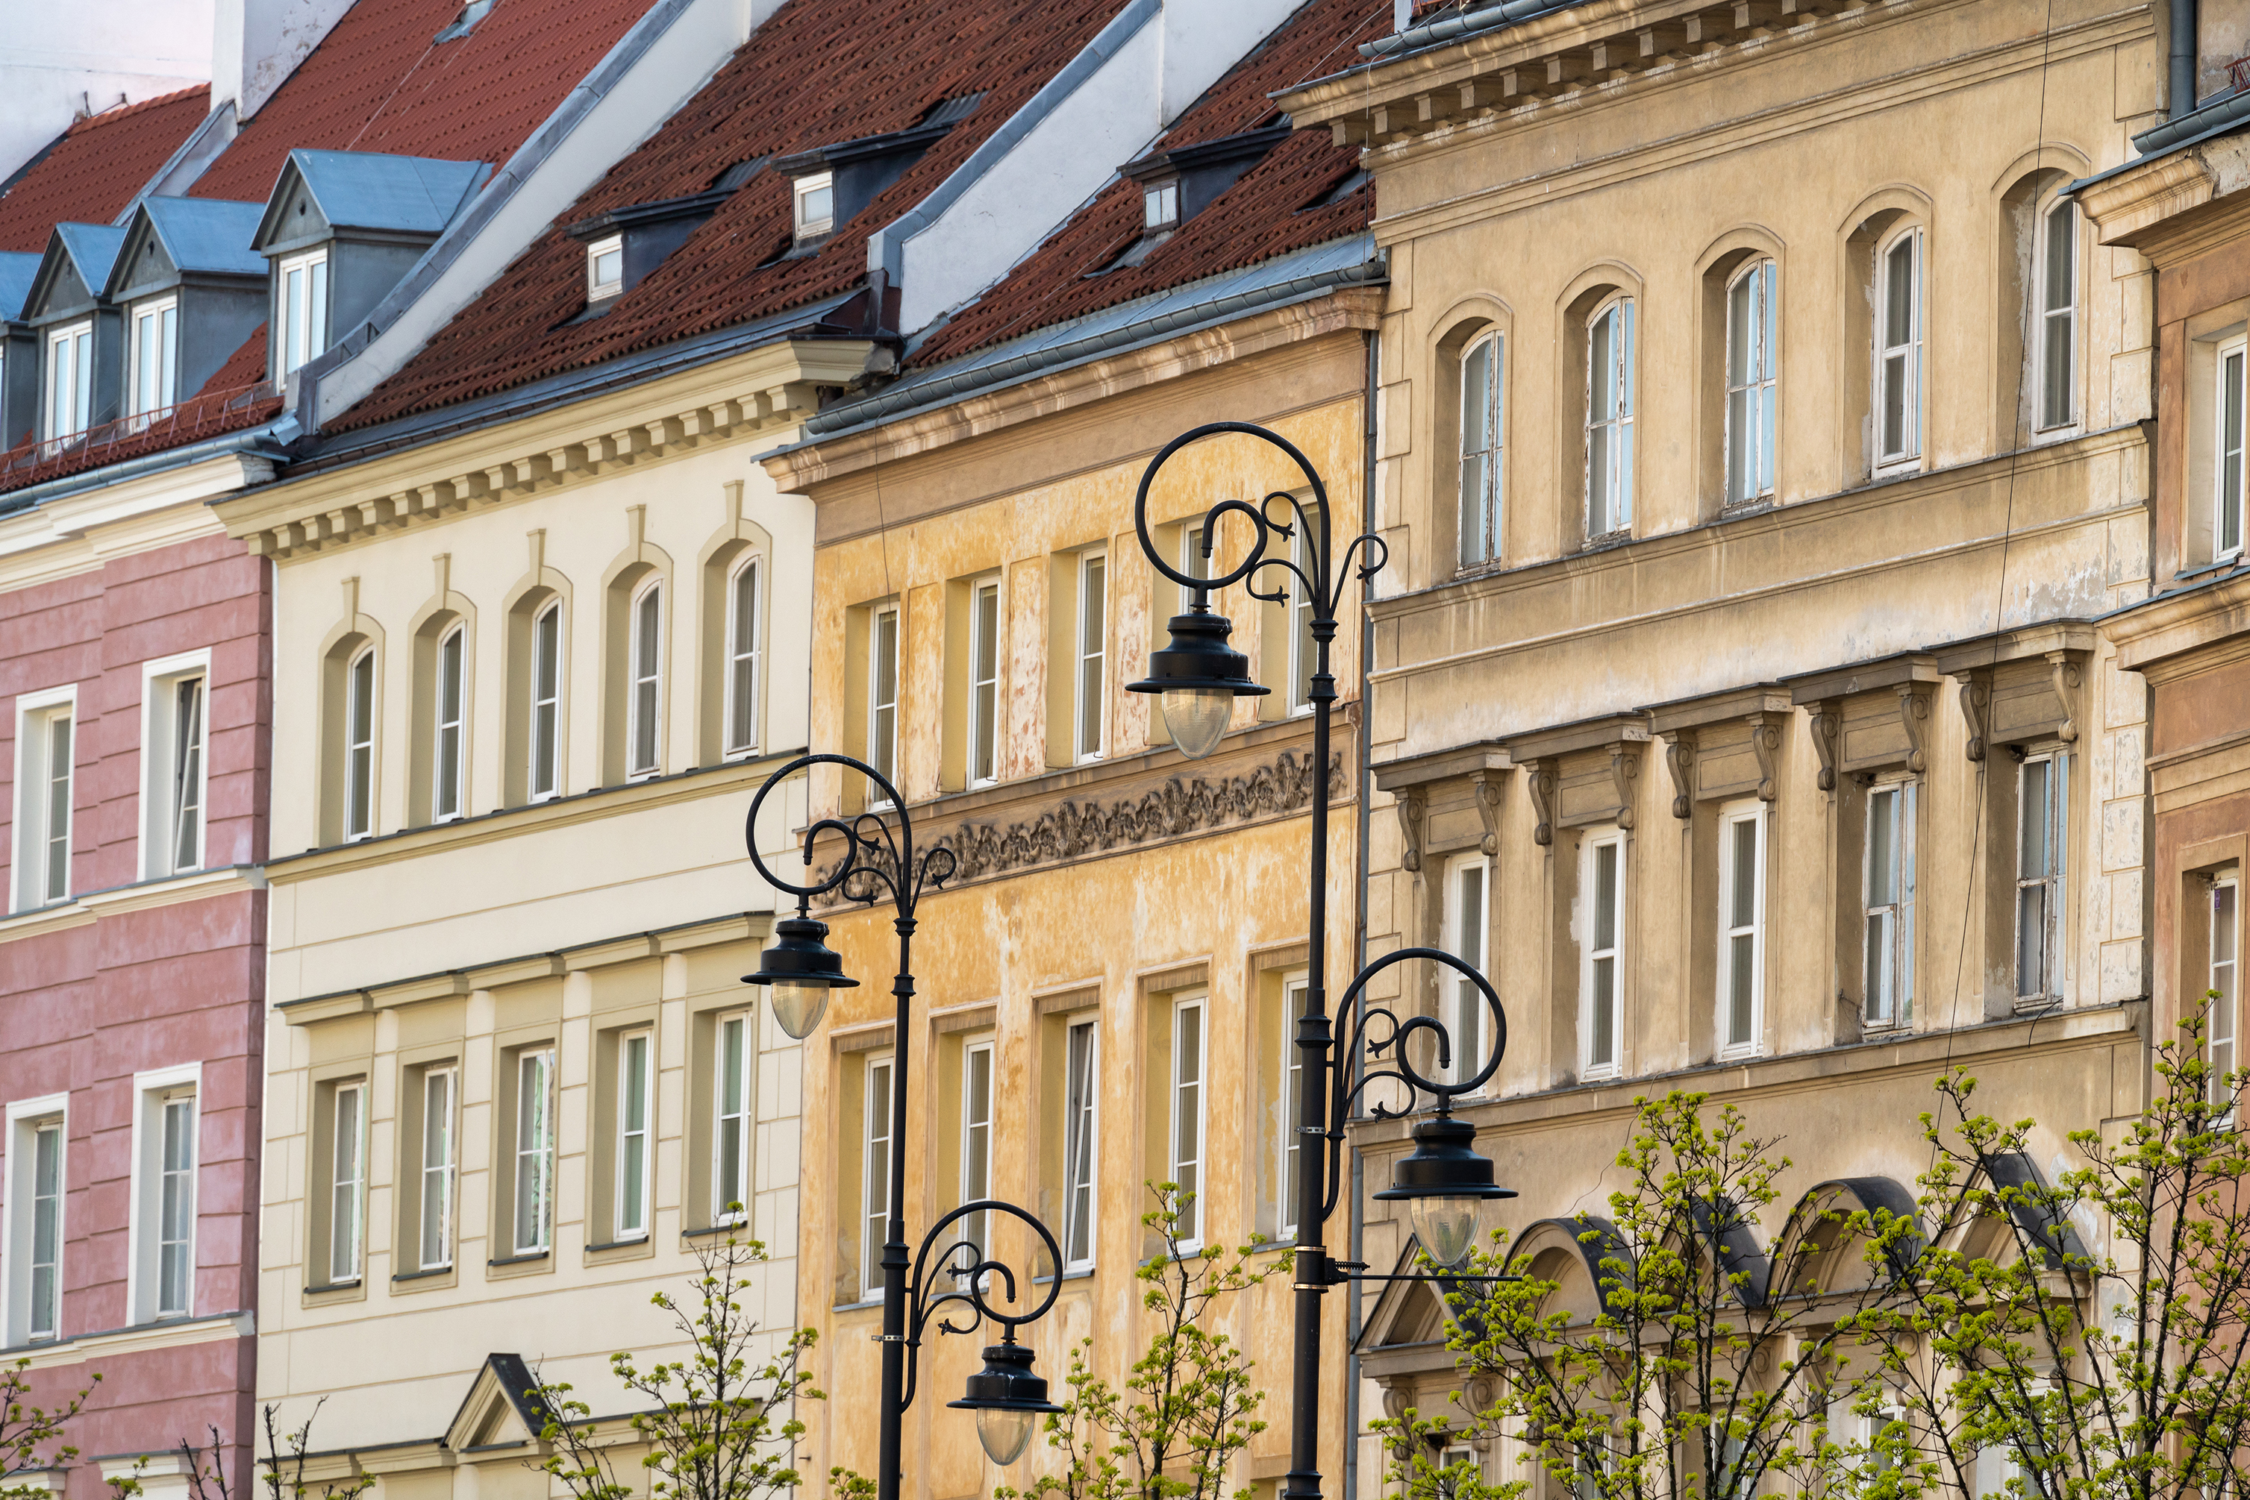
The question of culture
Why culture matters
"Little else is requisite to carry a state to the highest degree of opulence from the lowest barbarism, but peace, easy taxes, and a tolerable administration of justice: all the rest being brought about by the natural course of things."
-Adam Smith
Economics is a counterbalance to opposing interpretations
Culture can be explained by economic conditions

Slide 11
Relation to common text
Informal constraints
Formal Constraints
Enforcement
Organizations, learning and change
Page 75

